Slide 1
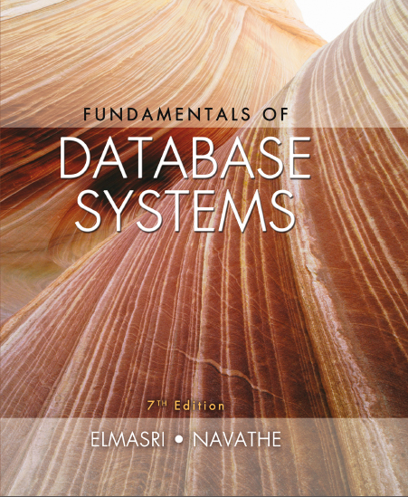
Fundamentals of Database Systems
Seventh Edition
Chapter 25
Big Data Technologies Based on MapReduce and Hadoop
Copyright © 2016, 2011, 2007 Pearson Education, Inc. All Rights Reserved
Notes:
If this PowerPoint presentation contains mathematical equations, you may need to check that your computer has the following installed:
1) MathType Plugin
2) Math Player (free versions available)
3) NVDA Reader (free versions available)

Slide 2
Introduction
Phenomenal growth in data generation
Social media
Sensors
Communications networks and satellite imagery
User-specific business data
“Big data” refers to massive amounts of data
Exceeds the typical reach of a D B M S
Big data analytics

Slide 3
What Is Big Data?
Big data ranges from terabytes
or petabytes
to exobytes
Volume
Refers to size of data managed by the system
Velocity
Speed of data creation, ingestion, and processing
Variety
Refers to type of data source
Structured, unstructured

Slide 4
What Is Big Data?
Veracity
Credibility of the source
Suitability of data for the target audience
Evaluated through quality testing or credibility analysis

Slide 5
Introduction to MapReduce and Hadoop
Core components of Hadoop
MapReduce programming paradigm
Hadoop Distributed File System (H D F S)
Hadoop originated from quest for open source search engine
Developed by Cutting and Carafella in 2004
Cutting joined Yahoo in 2006
Yahoo spun off Hadoop-centered company in 2011
Tremendous growth

Slide 6
Introduction to MapReduce and Hadoop
MapReduce
Fault-tolerant implementation and runtime environment
Developed by Dean and Ghemawat at Google in 2004
Programming style: map and reduce tasks
Automatically parallelized and executed on large clusters of commodity hardware
Allows programmers to analyze very large datasets (100s of GB to TB)
Underlying data model assumed: key-value pair
Batch processing
Automatic parallelization and distribution

Slide 7
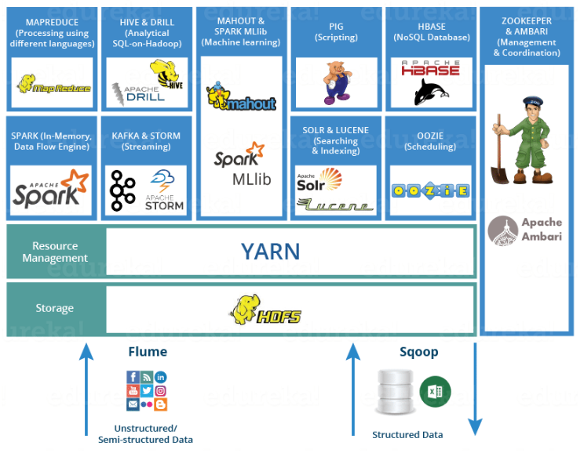
The Hadoop Ecosystem

Slide 8
The Hadoop Ecosystem
Related projects with additional functionality
HDFS: Hadoop Distributed File System
Pig : A scripting language that simplifies the creation of MapReduce jobs, and excels at exploring and transforming data
Hive: Provides SQL like access to big data
Oozie: Service for scheduling and running workflows of jobs
Sqoop: Library and runtime environment for efficiently moving data between relational databases and H D F S

Slide 9
The Hadoop Ecosystem
Related projects with additional functionality
H Base : Column-oriented key-value store that uses H D F S (NoSQL)
Storm: Framework that provides real-time processing of stream data
Spark: A fast and general engine for large scale data processing
Mahout: Machine Learning
Zookeeper: Managing Cluster
Solr: Searching & Indexing

Slide 10
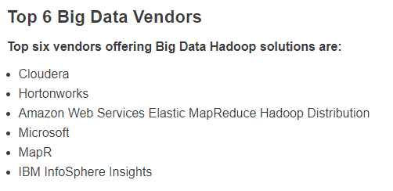
The Hadoop Ecosystem

Slide 11
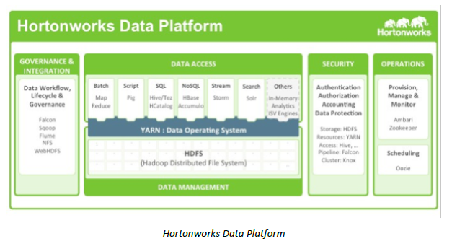
The Hadoop Ecosystem

Slide 12
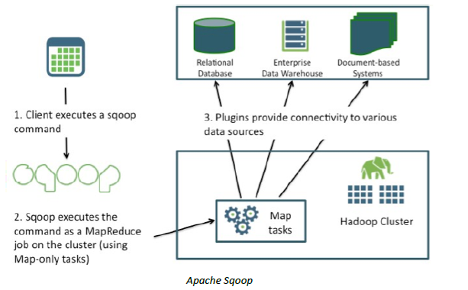
The Hadoop Ecosystem

Slide 13
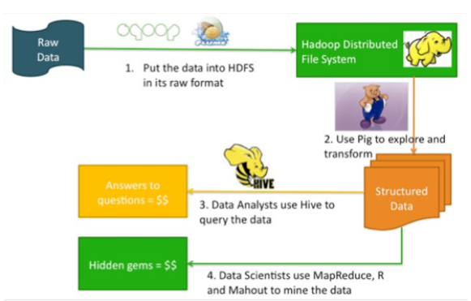
The Hadoop Ecosystem

Slide 14
The MapReduce Programming Model
Hadoop releases
1.x features
Continuation of the original code base
Additions include security, additional H D F S and MapReduce improvements
2.x features
Y A R N (Yet Another Resource Navigator)
A new MR runtime that runs on top of Y A R N
Improved H D F S that supports federation and increased availability

Slide 15
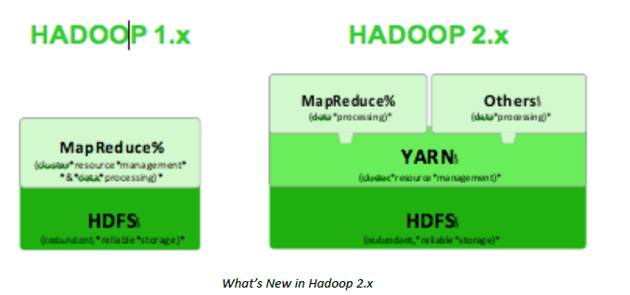
The MapReduce Programming Model

Slide 16
Hadoop Distributed File System
H D F S
File system component of Hadoop
Designed to run on a cluster of commodity hardware
Patterned after UNIX file system
Provides high-throughput access to large datasets
Stores metadata on NameNode server
Stores application data on DataNode servers
File content replicated on multiple DataNodes

Slide 17
Hadoop Distributed File System
H D F S design assumptions and goals
Hardware failure is the norm
Batch processing
Large datasets
Simple coherency model
H D F S architecture
Master-slave
Decouples metadata from data operations
Replication provides reliability and high availability
Network traffic minimized

Slide 18
Hadoop Distributed File System
NameNode
Maintains image of the file system
i-nodes and corresponding block locations
Changes maintained in write-ahead commit log called Journal
Secondary NameNodes
Checkpointing role or backup role
DataNodes
Stores blocks in node’s native file system
Periodically reports state to the NameNode

Slide 19
Hadoop Distributed File System
File I/O operations
Single-writer, multiple-reader model
Files cannot be updated, only appended
Write pipeline set up to minimize network utilization
Block placement
Nodes of Hadoop cluster typically spread across many racks
Nodes on a rack share a switch

Slide 20
Hadoop Distributed File System
Replica management
NameNode tracks number of replicas and block location
Based on block reports
Replication priority queue contains blocks that need to be replicated
H D F S scalability
Yahoo cluster achieved 14 petabytes, 4000 nodes, 15k clients, and 600 million files

Slide 21
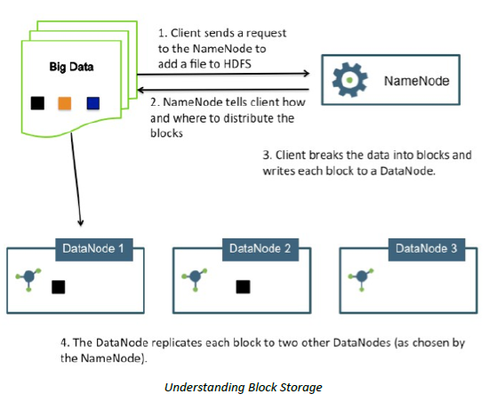
Hadoop Distributed File System

Slide 22
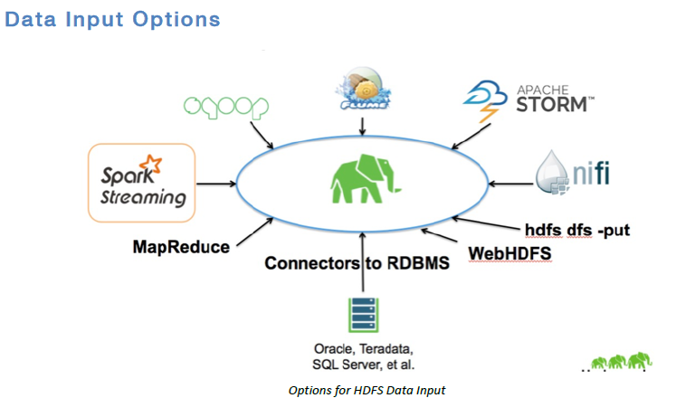
Hadoop Distributed File System

Slide 23
25.4 MapReduce: Additional Details
MapReduce runtime environment
JobTracker
Master process
Responsible for managing the life cycle of Jobs and scheduling Tasks on the cluster
TaskTracker
Slave process
Runs on all Worker nodes of the cluster

Slide 24
MapReduce: Additional Details (2 of 8)
Overall flow of a MapReduce job
Job submission
Job initialization
Task assignment
Task execution
Job completion

Slide 25
MapReduce: Additional Details
Fault tolerance in MapReduce
Task failure
Runtime exception
Java virtual machine crash
No timely updates from the task process
TaskTracker failure
Crash or disconnection from JobTracker
Failed Tasks are rescheduled
JobTracker failure
Not a recoverable failure in Hadoop v1

Slide 26
MapReduce: Additional Details
The shuffle procedure
Reducers get all the rows for a given key together
Map phase
Background thread partitions buffered rows based on the number of Reducers in the job and the Partitioner
Rows sorted on key values
Comparator or Combiner may be used
Copy phase
Reduce phase

Slide 27
MapReduce: Additional Details (5 of 8)
Job scheduling
JobTracker schedules work on cluster nodes
Fair Scheduler
Provides fast response time to small jobs in a Hadoop shared cluster
Capacity Scheduler
Geared to meet needs of large enterprise customers

Slide 28
MapReduce: Additional Details (6 of 8)
Strategies for equi-joins in MapReduce environment
Sort-merge join
Map-side hash join
Partition join
Bucket joins
N-way map-side joins
Simple N-way joins

Slide 29
Apache Pig
Bridges the gap between declarative-style interfaces such as S Q L, and rigid style required by MapReduce
Designed to for ad hoc analyses of Web logs/clickstreams
Accommodates user-defined functions
Apache Pig, http://pig.apache.org/, is a Hadoop platform for creating MapReduce jobs.
Created at Yahoo! to make it easier to analyze the data in your HDFS without the complexities of writing a traditional MapReduce program.
High-level SQL-like programming language named Pig Latin.

Slide 30
Apache Pig
The benefits of Pig include the ability to:
Run a MapReduce job with a few simple lines of code
Process structured data with a schema, or Pig can process unstructured data without a schema (Pigs eat anything)
Use a familiar SQL-like syntax in Pig Latin
Read and write data from HDFS with Pig scripts
Create code with a data flow language, a logical solution for many MapReduce algorithms

Slide 31
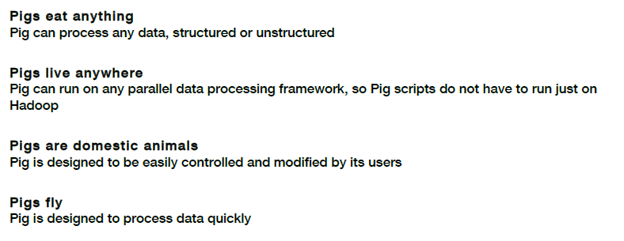
Apache Pig
Pig Latin – High level data-flow scripting language
Scripts can be executed through –
Pig script – pig latin script in a text file and Pig executable
Grunt Shell – interactive CLI
Embedded in Java – PigServer class to execute Pig query from Java

Slide 32
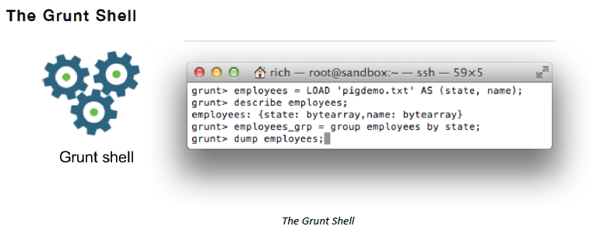
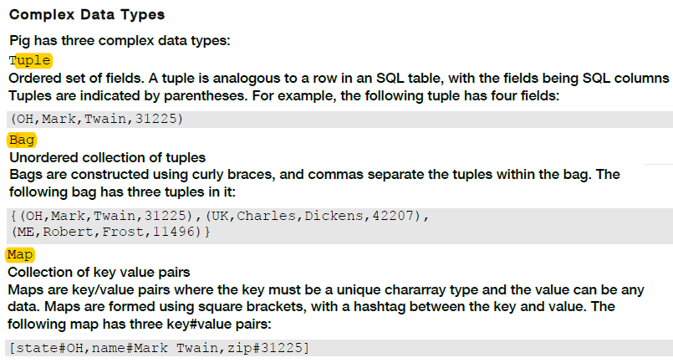
Apache Pig

Slide 33
Apache Hive
Apache Hive
Provides a higher-level interface to Hadoop using S Q L-like queries
Supports processing of aggregate analytical queries typical of data warehouses
Developed at Facebook

Slide 34
Apache Hive
Apache Hive, (http://hive.apache.org/), - Data warehouse system for Hadoop.
Not a relational database; it only maintains metadata information about your big data stored on HDFS.
Hive allows you to treat your big data as tables and perform SQL-like operations on the data using a scripting language called HiveQL.
Hive is not a database, but it uses a database (called the metastore) to store the tables that you define. Hive uses Derby by default
A Hive table consists of a schema stored in the metastore and data stored on HDFS
Hive converts HiveQL commands into MapReduce or Tez jobs (similar to how Pig Latin scripts execute with Pig)

Slide 35
Apache Hive
Benefits of HiveQL –
Similarity to SQL. Can run MapReduce jobs by writing SQL-like queries
Perform ad hoc custom queries on HDFS using Hive
Pig is a good choice for ETL jobs, where unstructured data is reformatted so that it is easier to define a structure to it
Hive is a good choice when you want to query data that has a certain known structure to it
You will likely benefit from using both Pig and Hive.
Pig is great for moving data around and restructuring it,
Hive is great for performing analyses on the data.

Slide 36
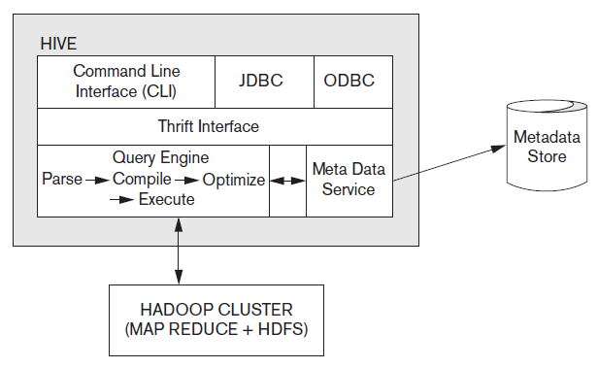
Hive System Architecture and Components
Figure 25.2 Hive system architecture and components

Slide 37
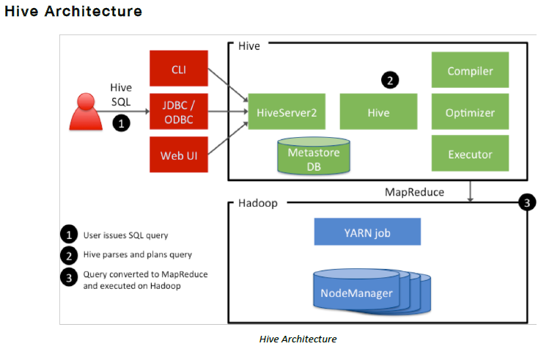
Hive System Architecture and Components

Slide 38
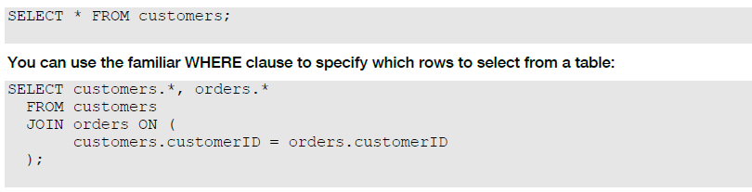
Hive System Architecture and Components
Defining Hive Tables
A Hive table allows you to add structure to your otherwise unstructured data in HDFS.
Following HiveQL creates a new Hive-managed table named customer:
CREATE TABLE customer (
customerID INT,
firstName STRING,
lastName STRING,
birthday TIMESTAMP,
) ROW FORMAT DELIMITED FIELDS TERMINATED BY ',’;
Loading Data into a Hive Table
LOAD DATA LOCAL INPATH '/tmp/customers.csv' OVERWRITE INTO TABLE customers;
Performing Queries

Slide 39
Advantages of the Hadoop/MapReduce Technology
Disk seek rate a limiting factor when dealing with very large data sets
Limited by disk mechanical structure
Transfer speed is an electronic feature and increasing steadily
MapReduce processes large datasets in parallel
MapReduce handles semistructured data and key-value datasets more easily
Linear scalability

Slide 40
25.5 Hadoop v2 (Alias Y A R N)
Reasons for developing Hadoop v2
JobTracker became a bottleneck
Cluster utilization less than desirable
Different types of applications did not fit into the MR model
Difficult to keep up with new open source versions of Hadoop

Slide 41
Y A R N Architecture
Separates cluster resource management from Jobs management
ResourceManager and NodeManager together form a platform for hosting any application on Y A R N
ApplicationMasters send ResourceRequests to the ResourceManager which then responds with cluster Container leases
NodeManager responsible for managing Containers on their nodes

Slide 42
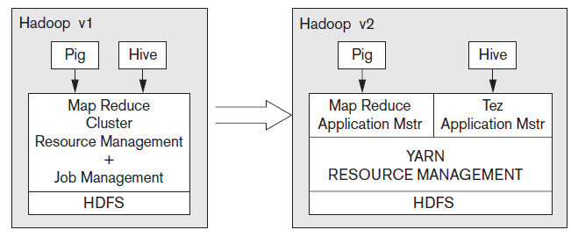
Hadoop Version Schematics
Figure 25.3 The Hadoop v1 versus Hadoop v2 schematic

Slide 43
Other Frameworks on Y A R N
Apache Tez
Extensible framework being developed at Hortonworks for building high-performance applications in Y A R N
Apache Giraph
Open-source implementation of Google’s Pregel system, a large-scale graph processing system used to calculate Page-Rank
Hoya: H Base on Y A R N
More flexibility and improved cluster utilization

Slide 44
25.6 General Discussion (1 of 7)
Hadoop/MapReduce versus parallel R D B M S
2009: performance of two approaches measured
Parallel database took longer to tune compared to MR
Performance of parallel database 3-6 times faster than MR
MR improvements since 2009
Hadoop has upfront cost advantage
Open source platform

Slide 45
General Discussion (2 of 7)
MR able to handle semistructured datasets
Support for unstructured data on the rise in R D B M S s
Higher level language support
S Q L for R D B M S s
Hive has incorporated S Q L features in Hive Q L
Fault-tolerance: advantage of MR-based systems

Slide 46
General Discussion (3 of 7)
Big data somewhat dependent on cloud technology
Cloud model offers flexibility
Scaling out and scaling up
Distributed software and interchangeable resources
Unpredictable computing needs not uncommon in big data projects
High availability and durability

Slide 47
General Discussion (4 of 7)
Data locality issues
Network load a concern
Self-configurable, locality-based data and virtual machine management framework proposed
Enables access of data locally
Caching techniques also improve performance
Resource optimization
Challenge: optimize globally across all jobs in the cloud rather than per-job resource optimizations

Slide 48
General Discussion (5 of 7)
Y A R N as a data service platform
Emerging trend: Hadoop as a data lake
Contains significant portion of enterprise data
Processing happens
Support for S Q L in Hadoop is improving
Apache Storm
Distributed scalable streaming engine
Allows users to process real-time data feeds
Storm on Y A R N and S A S on Y A R N

Slide 49
General Discussion (6 of 7)
Challenges faced by big data technologies
Heterogeneity of information
Privacy and confidentiality
Need for visualization and better human interfaces
Inconsistent and incomplete information

Slide 50
General Discussion (7 of 7)
Building data solutions on Hadoop
May involve assembling E T L (extract, transform, load) processing, machine learning, graph processing, and/or report creation
Programming models and metadata not unified
Analytics application developers must try to integrate services into coherent solution
Cluster a vast resource of main memory and flash storage
In-memory data engines
Spark platform from Databricks

Slide 51
25.7 Summary
Big data technologies at the center of data analytics and machine learning applications
MapReduce
Hadoop Distributed File System
Hadoop v2 or Y A R N
Generic data services platform
MapReduce/Hadoop versus parallel D B M S s

Slide 52
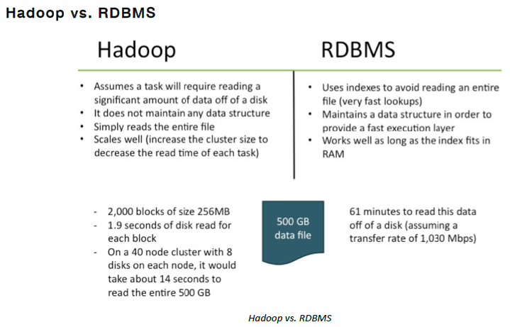

Slide 53
